Slide 1
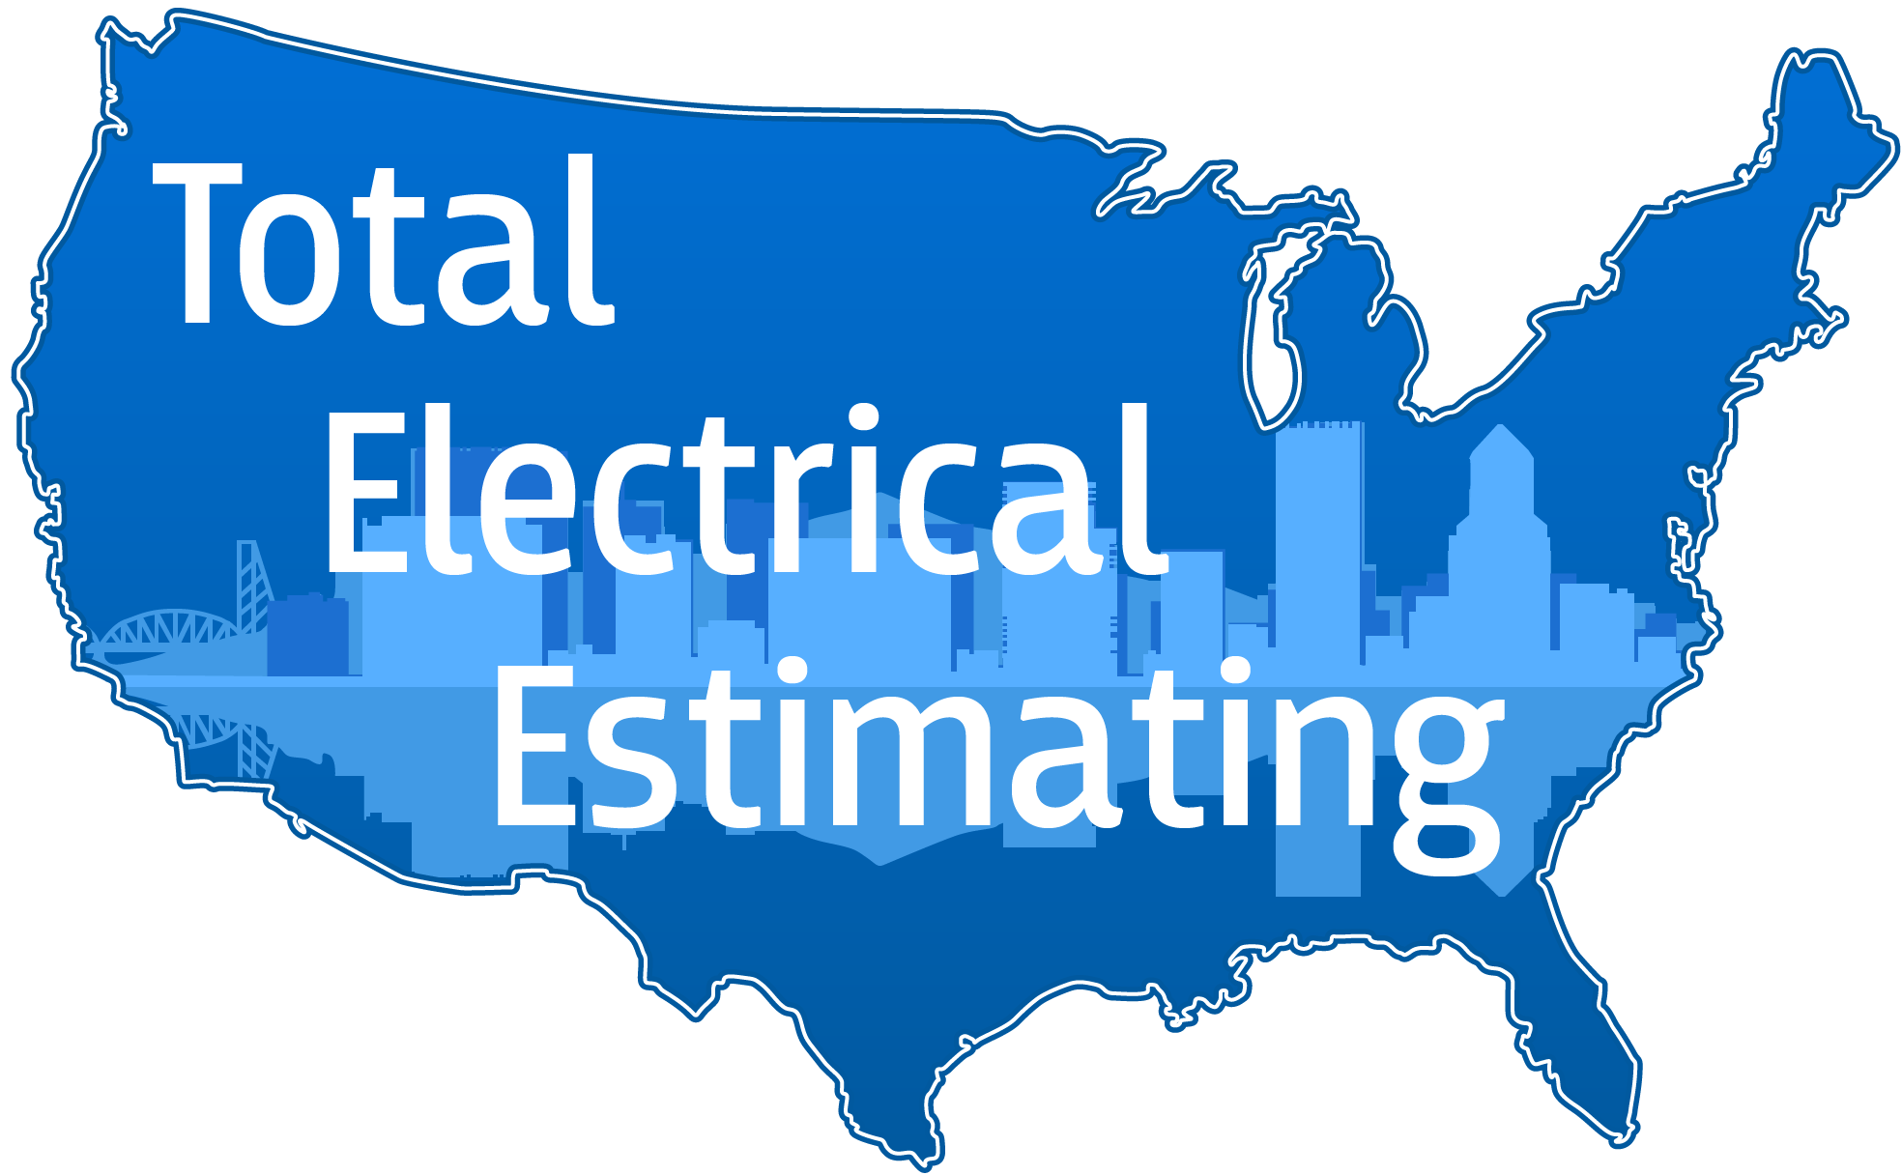
Ten Things I Wish I Would Have Known On My First Day As An Estimator.
By Louis McGaha

Slide 2
Keep Chopping Wood
As an estimator, any day when we win a job is a good day. Going in, know from the start that these days can be few and far between. Even the best estimator in the world will win a fraction of the jobs they bid every year. Many days, it will feel as if you’ve put out a winning proposal only to lose out to another bidder. The important thing is to not let this feel like a negative. Just keep working hard, doing your best. Good things will happen.

Slide 3
Learn From Losses
When a bid is unsuccessful, it’s important to try and understand why. Was there something we did wrong, or failed to do ? Did we bid in EMT when MC Cable was allowed ? Or did a desperate and/or stupid contractor buy the job out for pennies just to stay busy ? Another important factor to consider is who the job was bid to. If we’ve bid 30 jobs to a contractor and never won any of them, that’s an indicator that the competition with that contractor is too low for us to be competitive. If that’s the case, bidding to them is a waste of time.

Slide 4
Learn From Wins
Learning from successful bids is equally important. Why did we win ? It’s sometimes true that a winning bidder is the one who made the most mistakes. If there are mistakes in the bid, what can be done to balance them out ? What can be done to make sure it doesn’t happen again ? Post-bid, it’s important to review the actual labor and material compared to estimated. Were there certain phases of the job that were heavy or light on labor or material ? If so, this is the time to take action and get better on the next one.

Slide 5
Manage Stress
The responsibilities and duties of an estimator are of critical importance to the company and the people who work there. Being partially responsible for the livelihood of our fellow employees is an intense emotional and intellectual experience. It can put an enormous strain on anyone who’s not prepared for it. That being said, it is important to take care of ourselves physically, and manage our stress in a healthy way. Whether it’s yoga, biking, working on that old car in the garage, or just relaxing at home with the family, find a way to decompress every week if you can.

Slide 6
The Devil Is In the Details
Every square foot of a project costs money, and most of it will have at least a little electrical work in it. Every note, detail, and specification section can have language in it that might not sound like much but will cost big if it’s missed. Anyone can learn to count light fixtures and device symbols. The ability to identify and properly estimate work in these areas is one of the differences between an elite estimator and a mediocre one. The good news is that it all it takes is time and patience to excel at this.

Slide 7
It’s OK To Say “I Don’t Know”
“He who asks a question is a fool for five minutes; he who does not ask a question remains a fool forever”
Everyone in this industry had a unique path to get where they are today. The only thing we all have in common is that there’s always something we don’t know. It all depends on what we have been exposed to. Some know estimating but not project management, or vice versa. Some are masters on the job site but know nothing about the business side of running an electrical contractor. Everyone has weak links in their chain. So it’s ok to say “no” or “I don’t know”. Often someone will call and ask a question about a job that was bid 6 months ago. It’s ok to say “I don’t know, I’ll have to look into it and get back to you”. Answering a question with “Yes” when what you’re really thinking is “no” or “I don’t know” will usually cause problems later on. Try to avoid it.

Slide 8
Keep Learning
The code requirements, estimating software, and technology that drive the industry are constantly changing. It’s important to realize that we’re never really done learning. The changes in lighting control alone are completely different than they were 5, 10, 20 years ago. Buildings have more low voltage systems serving more equipment than ever before. Photovoltaic installations are on the rise as well. So there’s never really a point in an estimators career when they’ve learned all they need to know and can stop processing new information.

Slide 9
Shoot Straight
Reputations are hard to earn and easy to ruin. When dealing with suppliers, it’s good to be reserved in what information we share. Nothing makes them angrier than the perception of dishonesty. A supplier who thinks you cheated them out of a sale will be less likely to give you their best price in the future. Not only that, they will hold that grudge, and spread it to their peers around town. Having sharp pricing on quoted items such as light fixtures, switchgear, and fire alarm is crucial to a successful estimating team. Treating them fairly is a tremendous advantage.

Slide 10
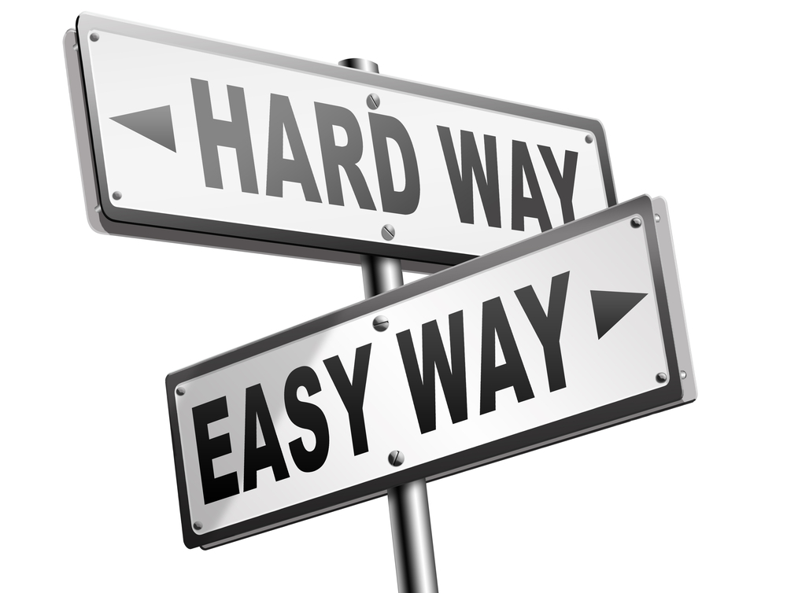
Stay Under Control
In the early phase of your time as an estimator, almost every day will present a task that you’re unsure how to perform correctly. When confronted with a task, note, or scope of work that is unfamiliar, seek help. It will be some time before a new estimator is experienced enough to work without supervision. If you’re not clear on exactly what is to be done, and exactly how to do it, ask someone who knows. Try to avoid guessing or winging it. The best case scenario for this is that we’ve created a problem that will take time and effort to solve before the bid goes out. The worst case scenario is that the mistake goes undetected during bidding, and costs the company money during construction.

Slide 11
An Estimator’s Best Friend
Understanding how to get the most out of your computer and it’s associated software will make you a better estimator. Knowing how to build a computer isn’t important. But being able to make use of estimating software, handle and organize documents, and most importantly, how to send and receive important communications is vital. This is the most important tool we have at our disposal. Use it wisely.

